Slide 1
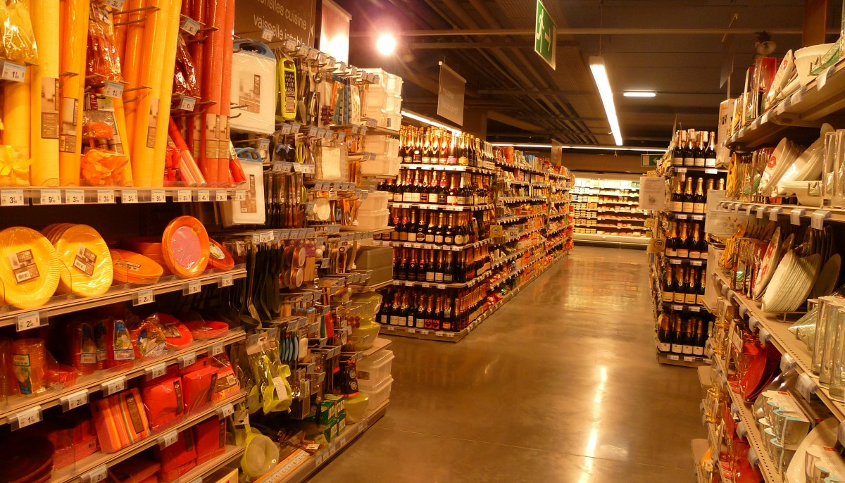
Olist Store Analysis
Uncovering E-commerce Trends with Data Analytics
BY
HEMALATHA LAGUDU

Slide 2
Introduction
Project Objective (Why this analysis?):
Olist is one of the largest e-commerce marketplaces in Brazil, connecting sellers with customers.
The goal of this analysis is to use data analytics to uncover sales trends, Customer behavior, and seller performance.
Main Goal: Understanding what drives customer satisfaction and revenue growth.

Slide 3

Introduction
Key Business Questions Answered :
Do customers place more orders on weekends or weekends?
Is the average payment value higher on weekends?
How many orders received a 5-star review and were paid via ………credit card?
What is the average delivery time for pet shop products?

Slide 4
Introduction
Key Business Questions Answered :
What is the average product price and payment value for ……….customers in Sao Paulo?
What is the relationship between shipping days and ……….customer review scores?
Does faster delivery lead to higher ratings?

Slide 5




Introduction
Tools Used :
Excel
Tableau
Data Cleaning & Basic Analysis.
Advance Visuals.
Power BI
MySQL
Microsoft Visualization Tool.
Data Extraction.

Slide 6
Dataset overview
Dataset Details
Source: Olist E-commerce public dataset(Brazil)
Time Period Covered: 2016 – 2018
No of Tables: 9(Orders, Payments, Reviews, Customers, ………Sellers, Products, Order Items, Geolocation, Category ………Translation.

Slide 7
Dataset overview
TABLES
Orders
IMPORTANT COLUMNS
order_id, order_purchase_timestamp, order_delivered_customer_date
DESCRIPTION
Tracks orders placed and delivered dates
Payments
Customers
Reviews
Sellers
Products
Order Items
payment_type, payment_value
customer_id, customer_city, customer_state
review_score, review_comment_title
seller_id, seller_state
product_id, product_category_name
order_id, product_id, price, freight_value
Records payment methods and amounts
Contains customer location details
Captures customer feedback and ratings
Stores seller details
Lists products and their categories
Links orders with products

Slide 8
Challenges & Solutions
Challenges
Missing or Null Values
Large Dataset Performance Issues
Complex SQL Joins & Relationships
Problem Faced
Missing order_delivered_customer_date, review_score, and payment_value caused incomplete analysis.
Power BI and Excel slowed down due to 100,000+ records.
Multiple tables (orders, payments, reviews, etc.) required complex joins, causing duplicates & data inconsistencies.
Solution Implemented
Used data imputation techniques (e.g., in Product table replaced null – 0, blank –”unidentified product” for column Category Name).
Optimized dataset by filtering unnecessary columns, using aggregated views, and DAX measures in Power BI.
Used primary-foreign key relationships, validated joins with test queries, and applied inner joins to remove duplicate entries.
Impact of Solution
Ensured data completeness, improving the accuracy of insights.
Reduced load time, making dashboards more interactive.
Ensured data accuracy & avoided incorrect aggregations.

Slide 9
Challenges & Solutions
Data Cleaning Steps
Standardized City Names: Different spellings of “Sao Paulo”(example ” São Paulo”) were standardized to “Sao Paulo using find and replace in Power Query.
Corrected Sellers Location Data: In sellers table city names were mistakenly entered as zip codes(example replaced “04482258” with “Rio De Janeiro”).
Handled Missing Values in Products Table: Replaced null to “0” & Blank values to Unidentified(for product category name).
Filled Missing Values in Reviews Data: In Reviews Table, missing values in review messages and titles were replace with “No Message” and “No Title” respectively.
Fixed Headers in Product Category Name Translation Table: Applied the “Use First Row as Headers” option to correctly structure the columns names.
Removed Duplicates & Cleaned Data: Identified and removed duplicate records to ensure data consistency.

Slide 10
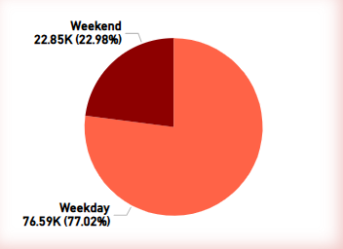
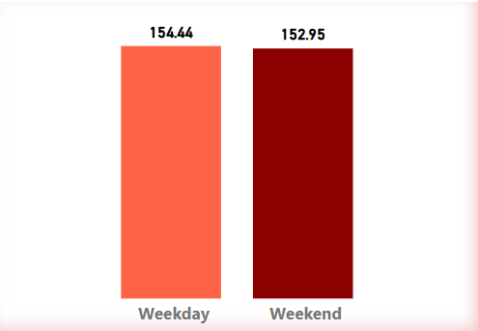
KPI - 1
WEEKDAY VS WEEKEND (ORDER_PURCHASE_TIMESTAMP) PAYMENT STATISTICS
Count of orders placed and Average payment value is more on weekdays (~77%, $154.44) as compared to weekends(~23%, $152.95)
The least number of orders placed are observed on Saturday (10,887), whereas highest is observed on Monday (16196).
Average Payment value is observed to be highest on Monday and least on Sunday.
Promotions, discounts and advertising campaigns can be strategically planned to maximize customer engagement and sales.
Weekend
Weekday

Slide 11
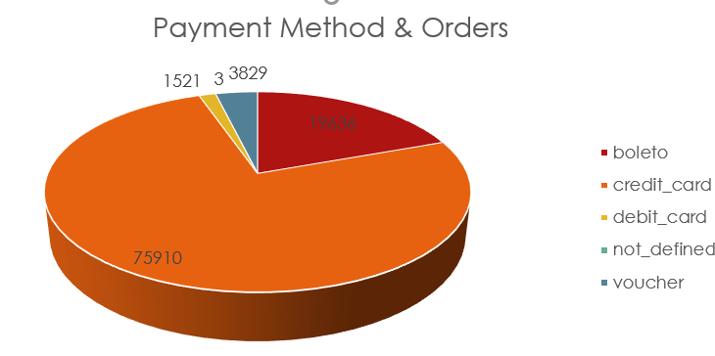
KPI - 2
TOTAL NUMBER OF ORDERS WITH REVIEW SCORE 5 AND PAYMENT TYPE AS CREDIT CARD
Approximately 77% of the customers prefer credit card as a payment method and 58% of the reviews are rated 5 for this payment type.
The highest Orders with review score 5 using credit card is 43981 & The average review score is 4.09
Monitoring the relationship between the number of credit card orders and review scores over time is crucial as it allows assess customer satisfaction and identify any changes or trends that may require attention or improvement.
The customer reviews should be analysed/read carefully and proper solution to the mentioned problems need to be identified to improve the review scores for least rated orders.

Slide 12
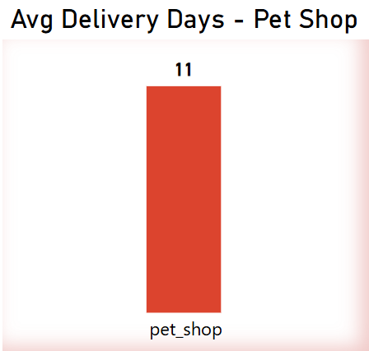
KPI - 3
Average number of days taken for order_ delivered _customer _ date for pet_ shop
For product category pet shop it is observed that it takes average of 11 delivery days approximately.
This KPI helps businesses understand how long it typically takes to deliver products within the pet shop category. If 11 days is considered too long, improvements in logistics and supply chain efficiency may be required to reduce delivery times and enhance customer satisfaction.

Slide 13
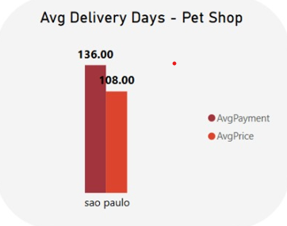
KPI - 4
Average price and payment values from customers of Sao Paulo city
Approximate values for both Avg payment value and Avg price as 136 and 108.
From the analysis, it shows that Sao Paulo city is paying more that the base price of products, possibility due to
Shipping costs or additional fees
Higher-priced items or premium services
Multiple product purchases in a single transaction

Slide 14
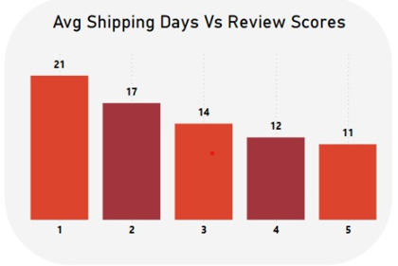
KPI - 5
Relationship between shipping days Vs review scores.
As average delivery days decrease, the review scores increase.
This suggests that faster deliveries lead to better customer ratings.
If a company wants higher customer satisfaction , optimizing delivery time can significantly impact rating.
Implementing faster shipping methods, better logistics and real-time tracking may help reduce delivery time

Slide 15
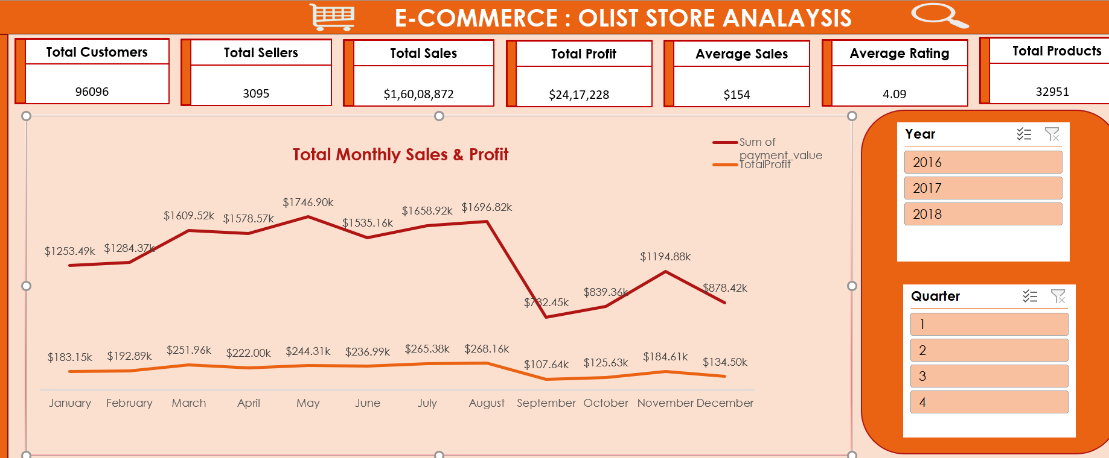
Excel Dashboard

Slide 16
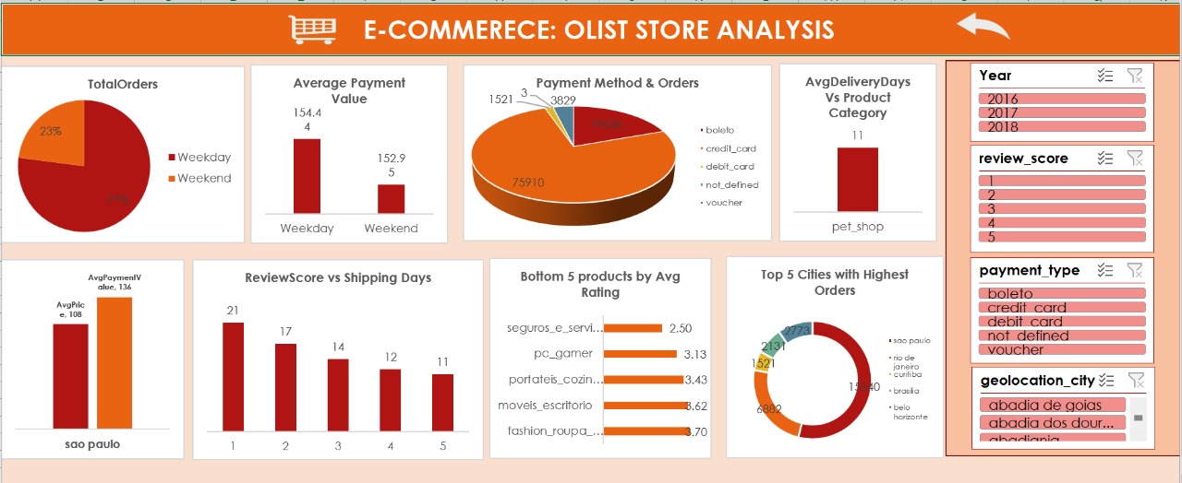
Excel Dashboard

Slide 17
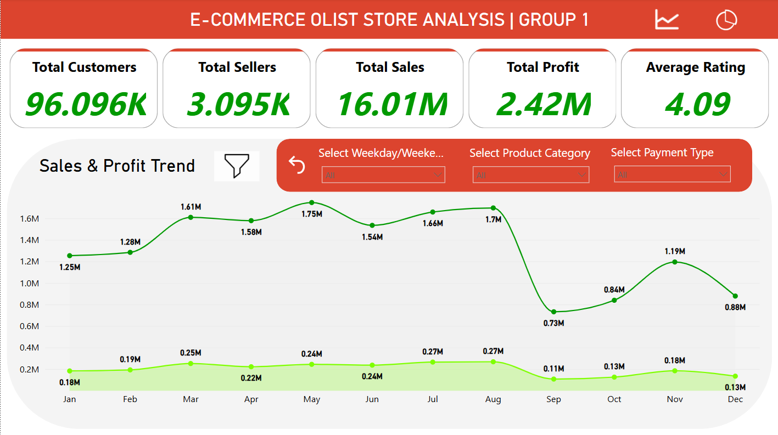
Power BI Dashboard

Slide 18
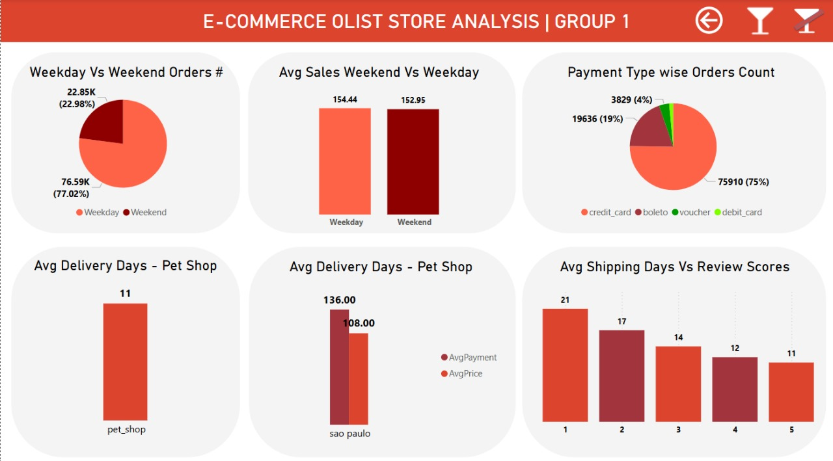
Power BI Dashboard

Slide 19
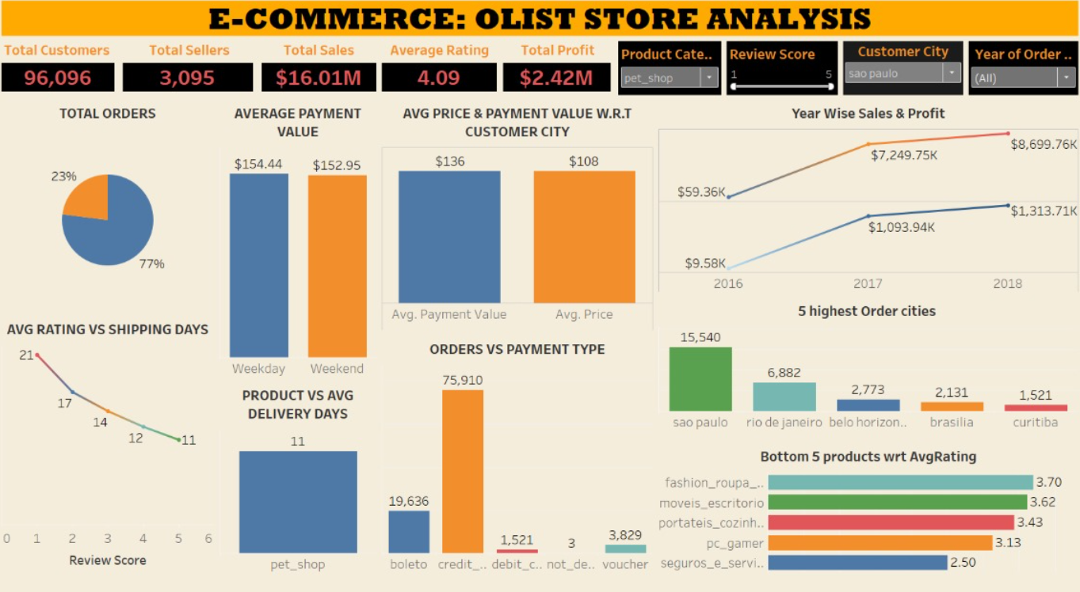
Tableau Dashboard

Slide 20
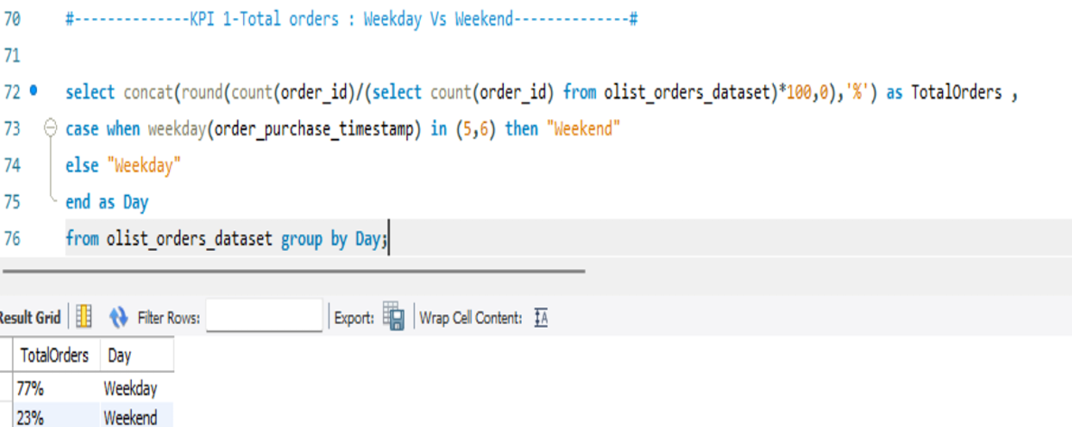
MySQL Queries
KPI 1: Weekday Vs Weekend (order_purchase timestamp) payment statistics

Slide 21
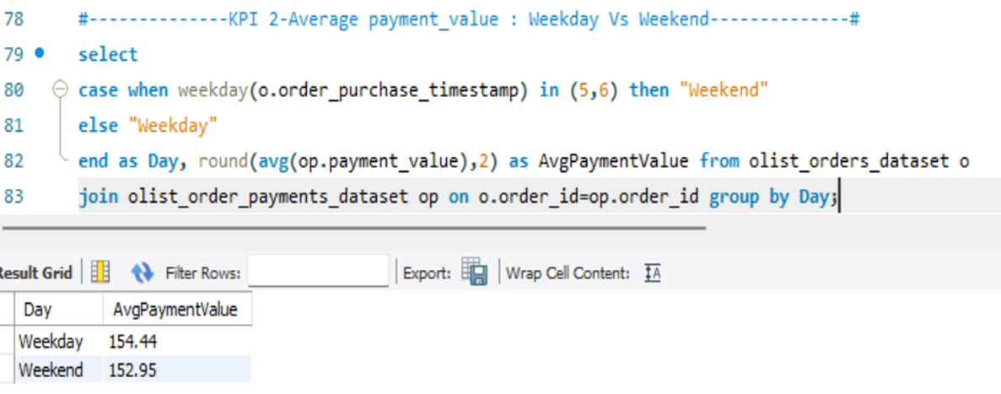
MySQL Queries
KPI 2: Average payment_value : Weekday Vs Weekend

Slide 22
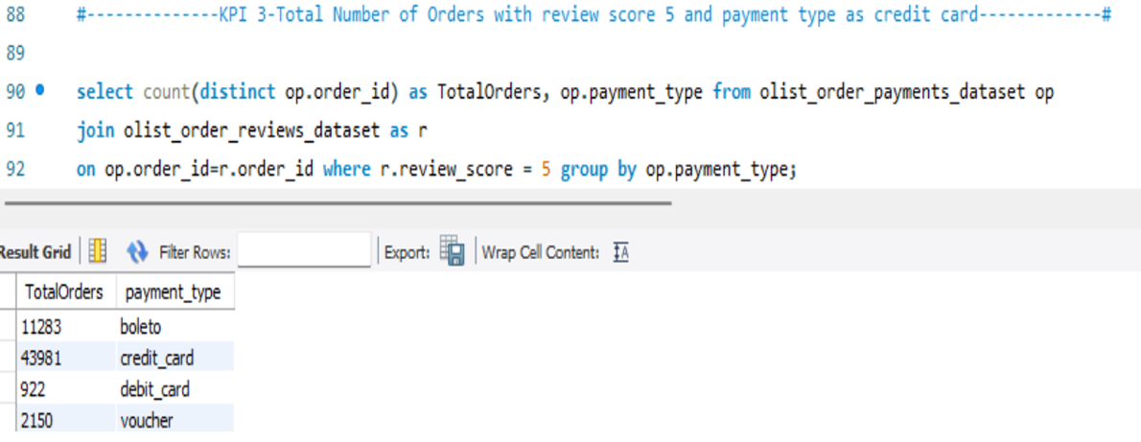
MySQL Queries
KPI 3: Total Number of Orders with review score 5 and payment type as credit card

Slide 23
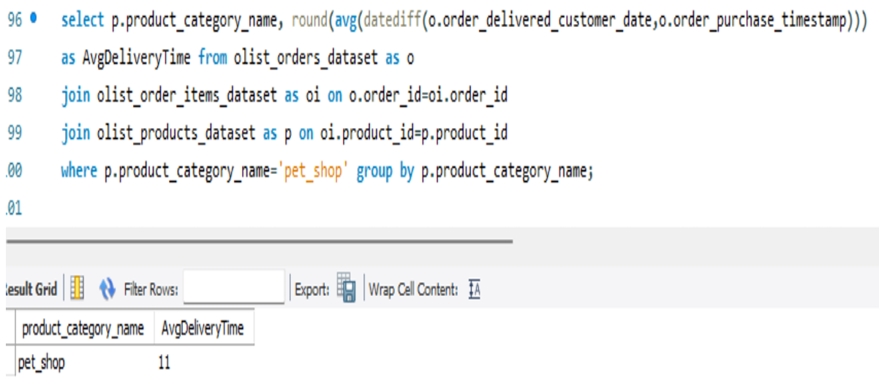
MySQL Queries
KPI 4: Average number of days taken for order_delivered_customer_date for pet_shop

Slide 24
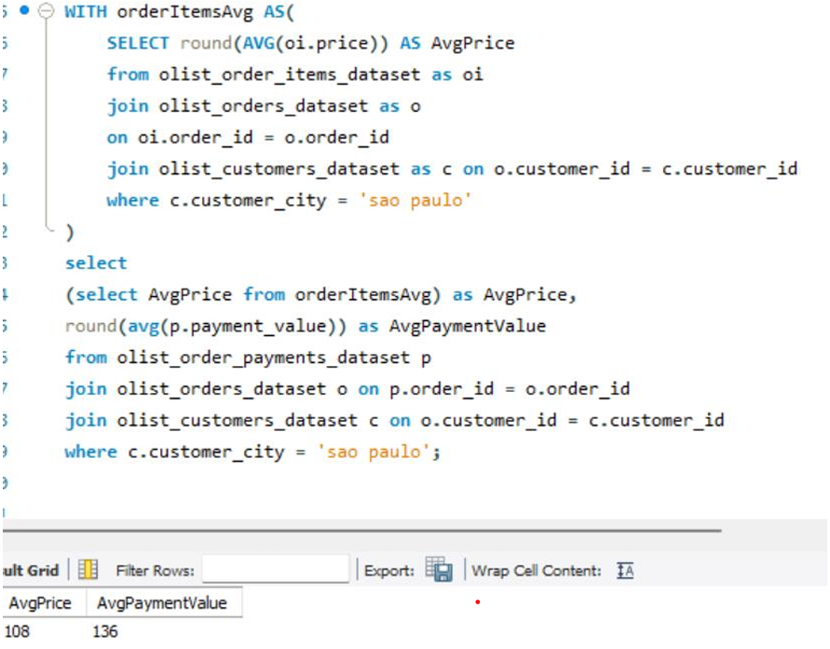
MySQL Queries
KPI 5: Average price and payment values from customers of sao paulo city

Slide 25
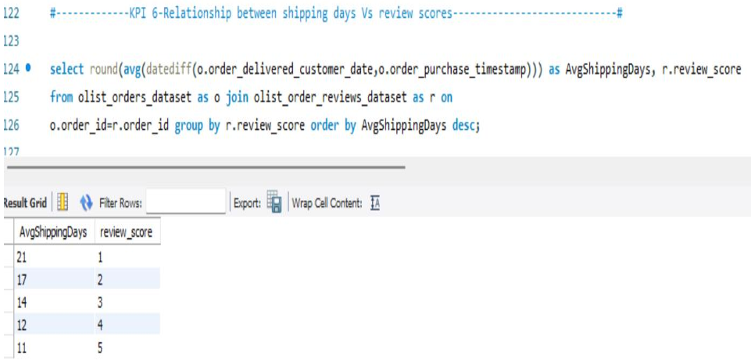
MySQL Queries
KPI 6: Relationship between shipping days Vs review scores

Slide 26
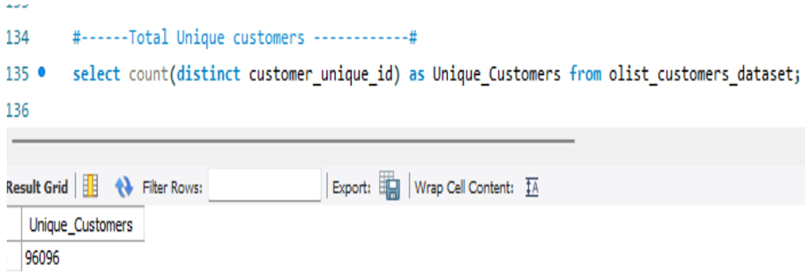
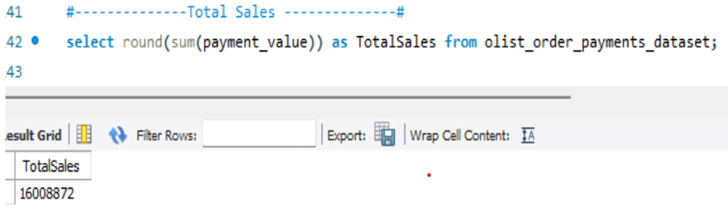
MySQL Queries
Total Unique Customers
Total Sales

Slide 27
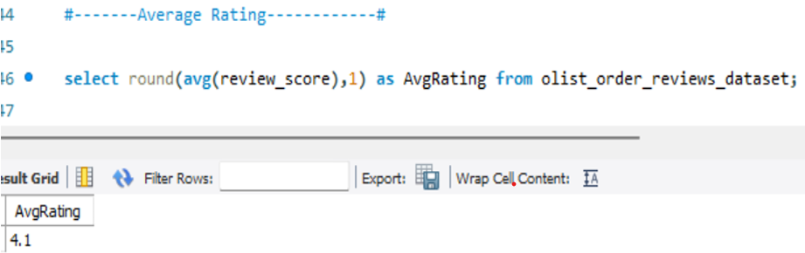
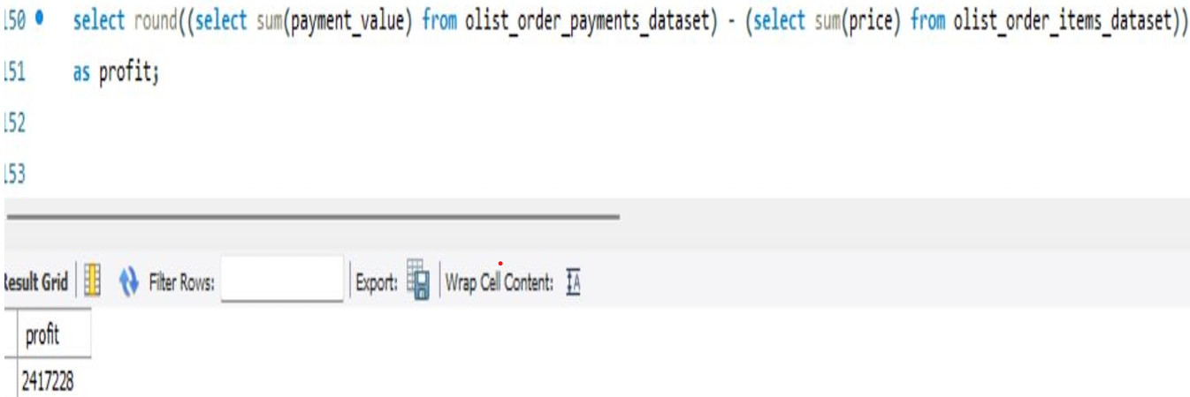
MySQL Queries
Average Rating
Total Profit

Slide 28
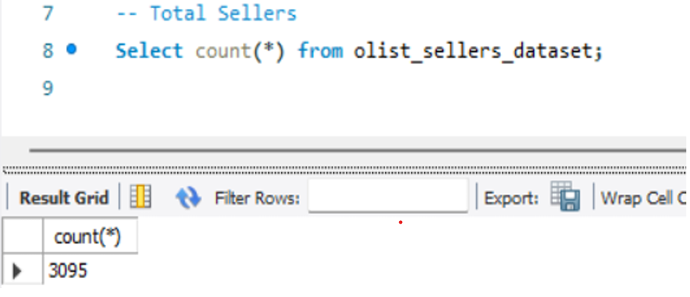
MySQL Queries
Total Sellers

Slide 29
Conclusions
Market Insights:
Sao Paulo stands out with the highest order volume, indicating a robust market presence. This city should be the focal point for targeted marketing and promotional efforts.
Payment Preferences:
The analysis reveals diverse payment method preferences among customers.
Understanding these preferences is crucial for optimizing the checkout experience and reducing cart abandonment rates.

Slide 30
Conclusions
Logistics Challenges:
Delivery times vary significantly across cities, with some experiencing delays.
This inconsistency can negatively affect customer satisfaction and loyalty, making it a critical area for improvement.
Customer Feedback:
Positive review scores indicate a generally satisfied customer base; however, there are opportunities for improvement that could elevate overall customer experience.

Slide 31
Recommendations
Targeted Marketing:
Increase marketing efforts in Sao Paulo to leverage its high order volume.
Consider localized advertising strategies that resonate with this demographic.
Enhance Payment Options:
Introduce additional payment methods to cater to customer preferences. This could include digital wallets or installment payment options, which may increase conversion rates.
To attract more customers through credit card partnerships, offer cashback, reward points, exclusive discounts, and EMI options for credit card users. Run limited-time promotions and provide freebies or perks like free shipping and vouchers. These strategies encourage spending and improve customer retention.

Slide 32
Recommendations
Logistics Optimization:
Invest in logistics solutions to streamline delivery processes, particularly in cities with longer delivery times.
This could involve partnerships with local delivery services or enhancements in supply chain management.
Customer Engagement:
Foster a culture of customer feedback by actively soliciting reviews and responding to them.
Consider implementing loyalty programs that reward customers for their feedback and repeat purchases.

Slide 33
THANK YOU

